Slide 1

NBA SEASON 2013
Apostolopoulos Vasilis
Leonidas Konti

Slide 2
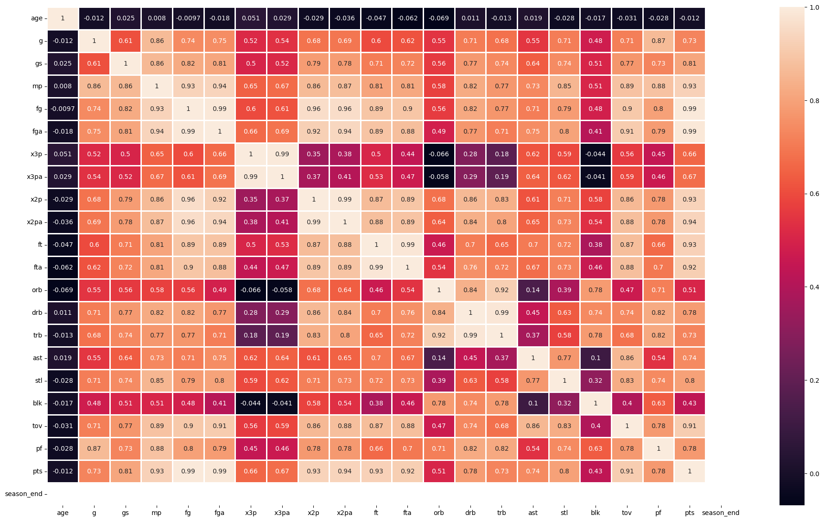
Principal Components:
mp (Minute Played)
ast (Assists)
trb (Total Rebounds)

Slide 3
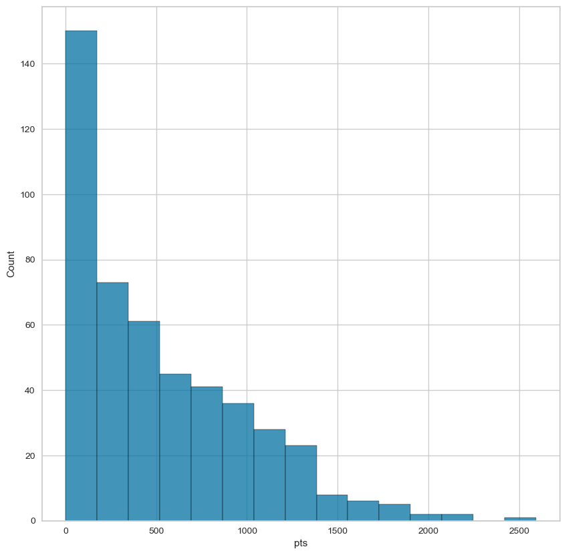
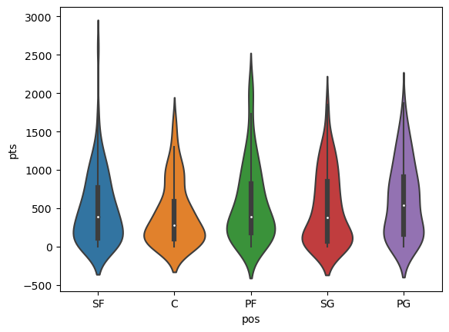
Points to players distribution
Points in relation to playing position

Slide 4
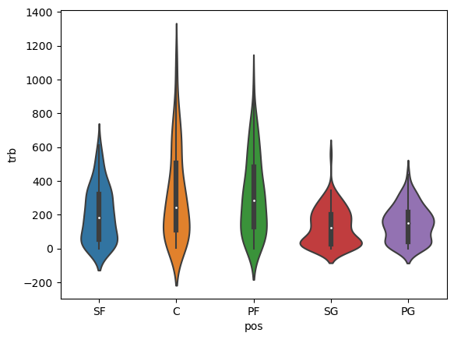
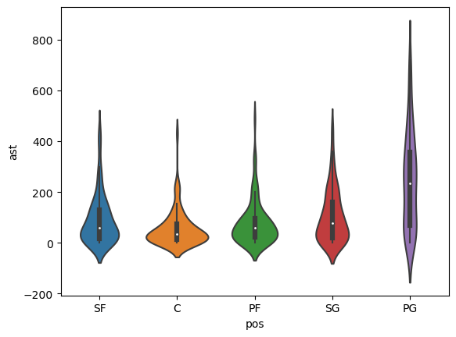
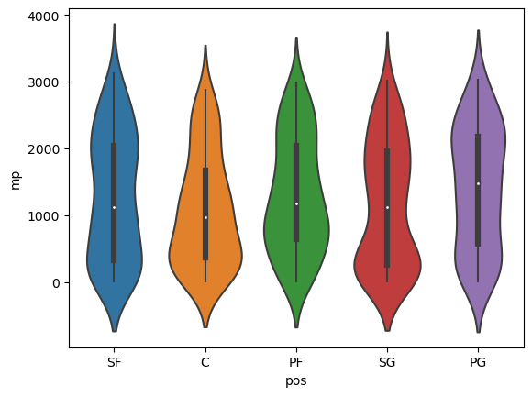
Total Rebounds in relation to playing position
Assists in relation to playing position
Minutes Played in relation to playing position

Slide 5
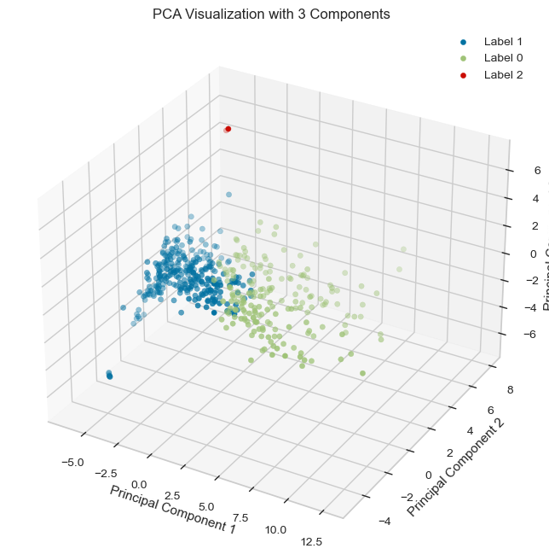
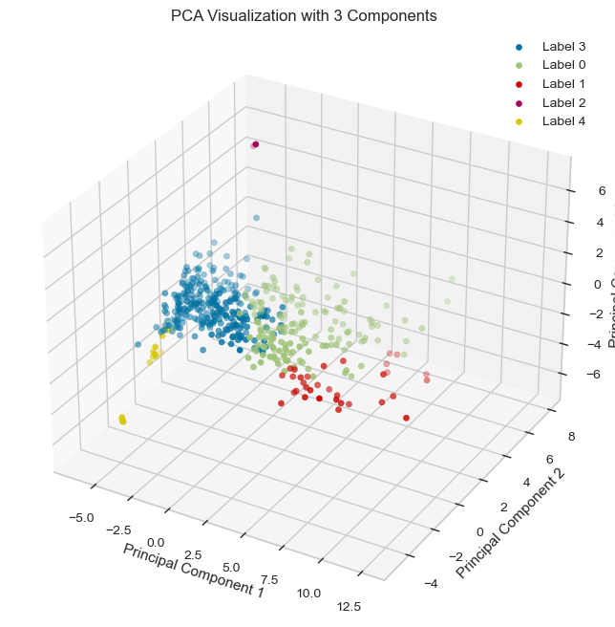
Standard Scaling &
Agglomerative Clustering
(3 & 5 Clusters)

Slide 6
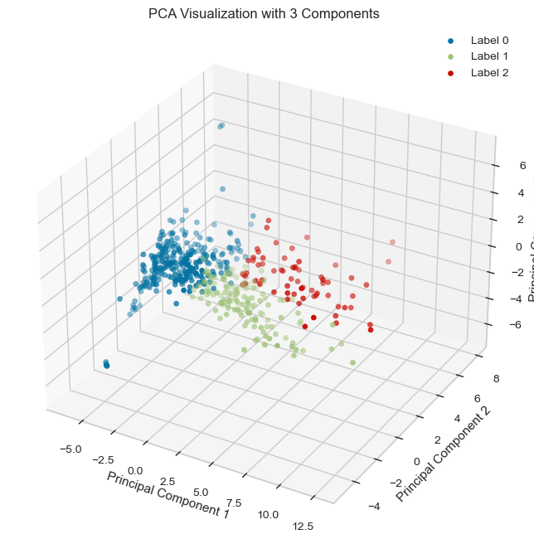
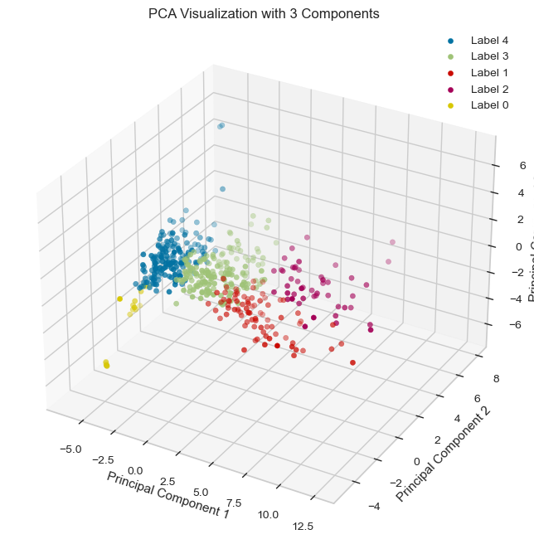
Standard Scaling & K-Means
(3 & 5 Clusters)

Slide 7
